Slide 1
DDS Beer EDA Allen Hoskins and Fidel Tamares
Allen Hoskins: https://github.com/ahosk/MSDS-Case-Study-1
Fidel Tamares: https://github.com/fideltamares/MSDS6306-_DDS_Case_Study1.git

Slide 2
Dataset Review: Assumptions
1005 Beers removed for missing IBU data
We cannot infer preference by the number of each style in a state
Style saturation is less of a threat than a brewery that has many styles
Style guidelines determine beer ingredients/ABV/IBU ranges; style data is intact
Beer sales are assumed to be made within the home state
National/Regional distribution not considered
Breweries are analyzed as independent of a parent company’s ownership in other breweries
*3. Address the missing values in each column

Slide 3
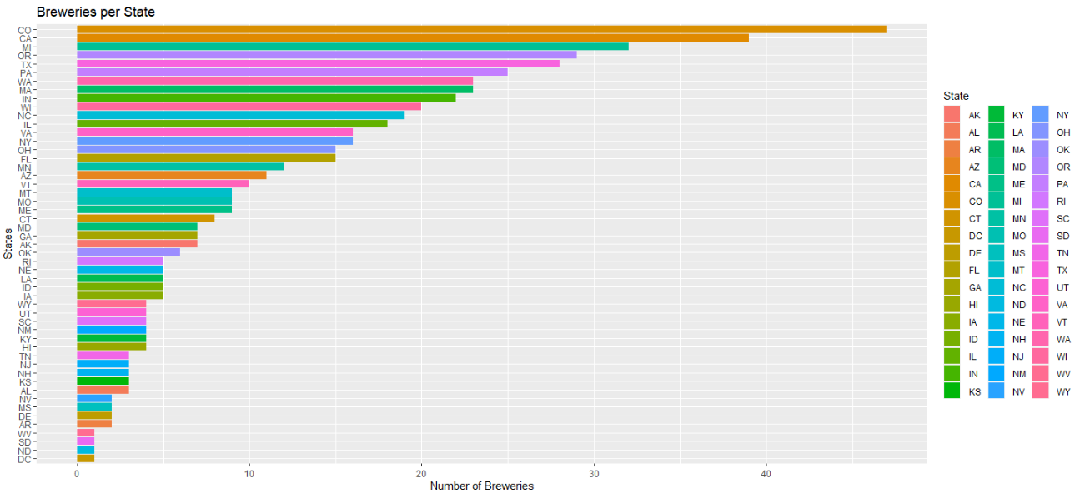
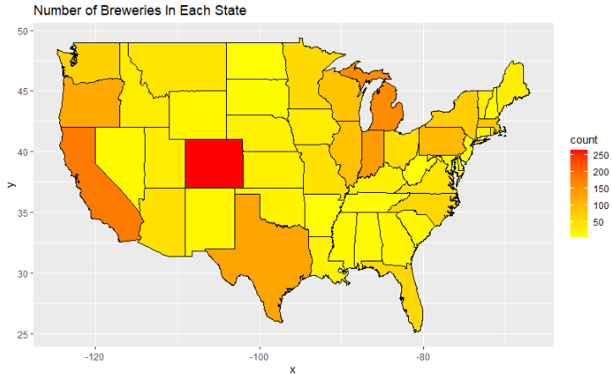
Basic Brewery and State information
States Average 11 breweries
5 States have more than 28 breweries
Total Beers Catalogued: 2,410
Total Breweries Cataloged: 558
Top 3 States by Styles of Beer:
Colorado with 265 Styles
California with 183 Styles
Minnesota with 162 Styles
*1. How Many Breweries are there in each state

Slide 4
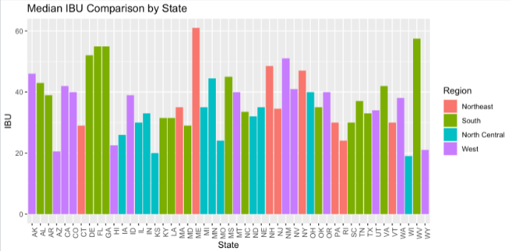
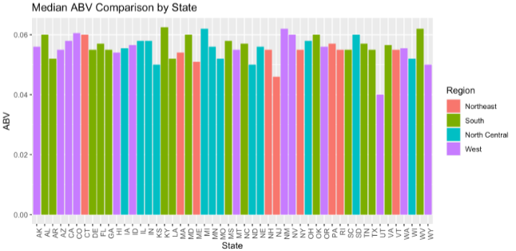
Dataset Review: Regional Preferences
IBU ranges from 4 to 138
The center of this range is 35 IBUs
The highest IBU Beer belongs to Astoria Brewing in Oregon
Top 3 Styles:
American IPA
American Pale Ale
American Amber Ale
Top 3 Breweries with most styles
Brewery Vivant, 62, Michigan
Oskar Blues Brewery, 46, North Carolina
Sun King Brewery, 38, Indiana
ABV ranges from .1% to 12.8%
The center of this range is 5.6%
The highest ABV Beer belong to Upslope Brewing in Colorado
*4. State and Region IBU Comparison *5. Highest IBU Beer

Slide 5
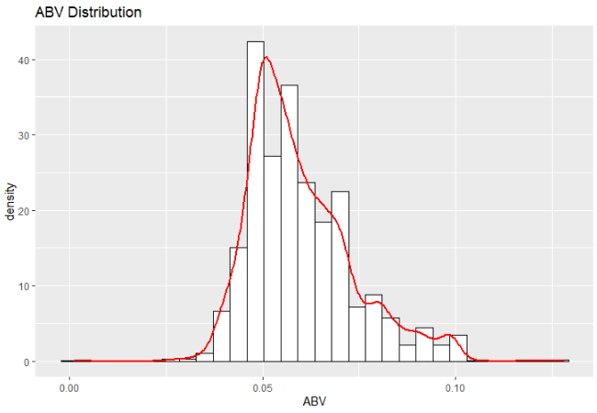
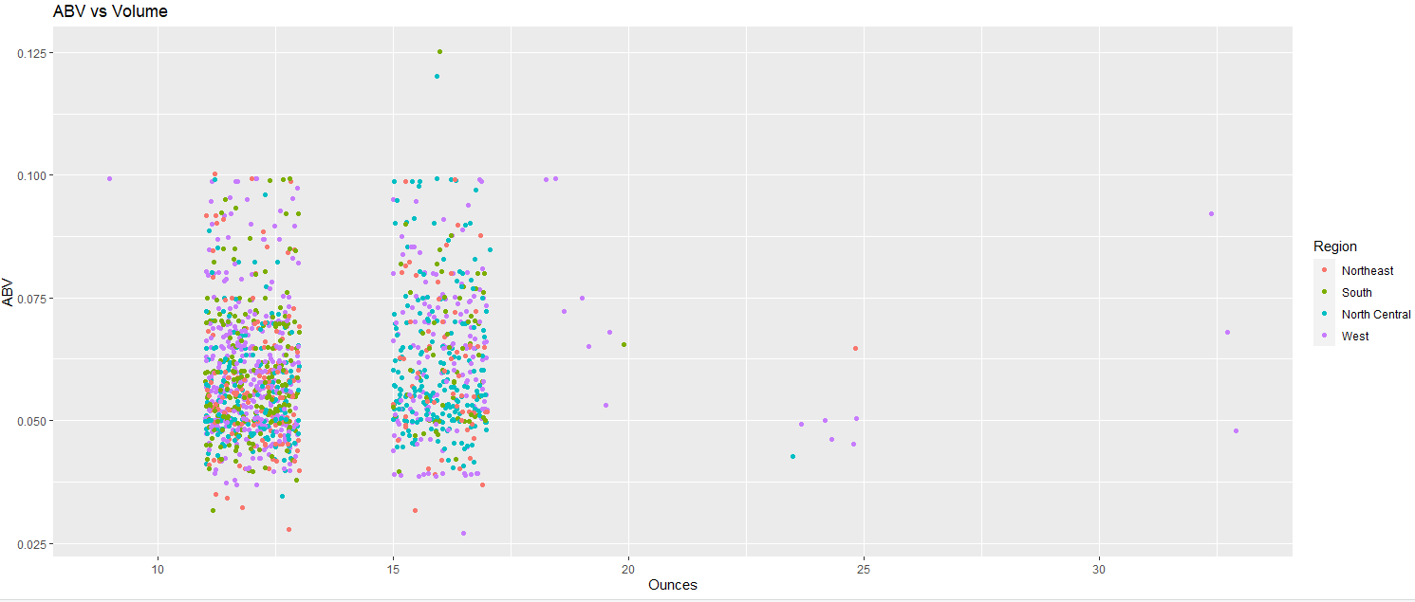
Dataset Review: Regional Preferences cont.
Average ABV: 5.97%
There is evidence that suggests there is a market is moving towards higher ABV
Session beer (Less than 5% ABV) trend is declining
Most popular serving size is 12oz
This is inline with can sizes
Assumption is most consumption is not on site
16oz is the next most popular size
This is inline with Pint Glass Sizes
Assumption is consumption is onsite or in a restaurant/pub
1,525 Data Points
841 Data Points
6. Compare summary statistics and distribution of the ABV Variable

Slide 6
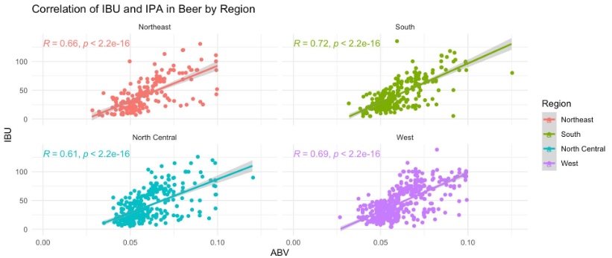
Dataset Review: Changes in Beer Preference
Trends are moving towards big bodied beers (5%+ * and 40+IBU **)
There is a moderate correlation in Northeast and Northwest
May be more open to experimental lighter, full bodied beers like stouts
There is moderate/strong correlation in the South and West
May be more open to experimental big body beers, quads and IPAs
One could assume overall change in the market for beer styles
*5% Max ABV for session beers
**40 IBU max style range for Pale Ale, 40+ Can be considered IPA
7. Examine the relationship between the bitterness of the beer and its alcohol content

Slide 7
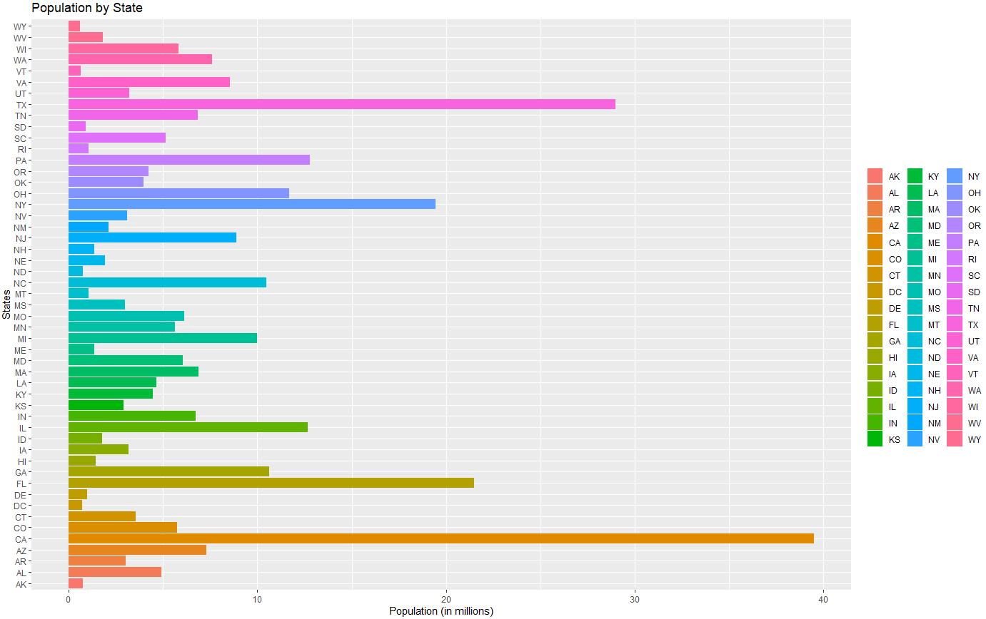
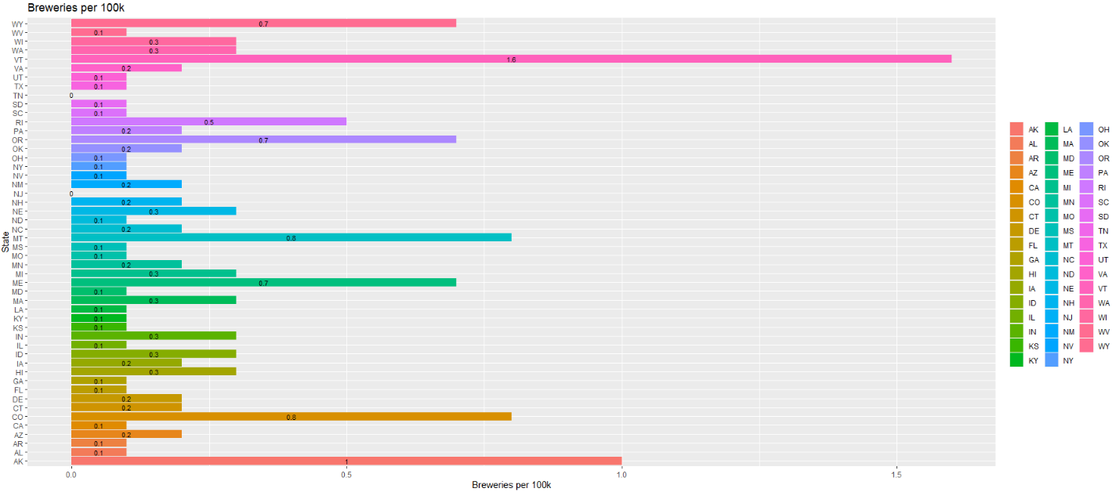
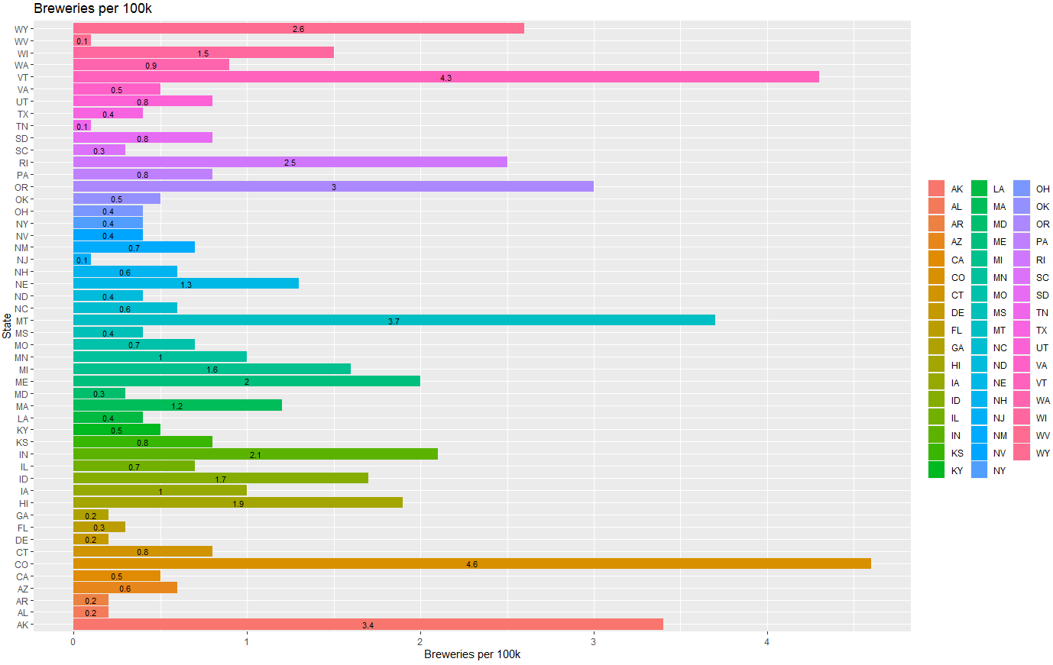
Key Takeaways and Recommendations
Markets considered saturated (CA,TX, OH, GA) are low in Breweries per Capita but have high in population
The are not saturated, most likely dominated by a few larger breweries with many styles
Movement towards bigger beers (5%+ and 40 IBU+)
Locations may not be critical, most beer sales are in can sizes (12oz)
Important factors to open new business: Regional customer preference and number highly capable competitors

